Slide 1
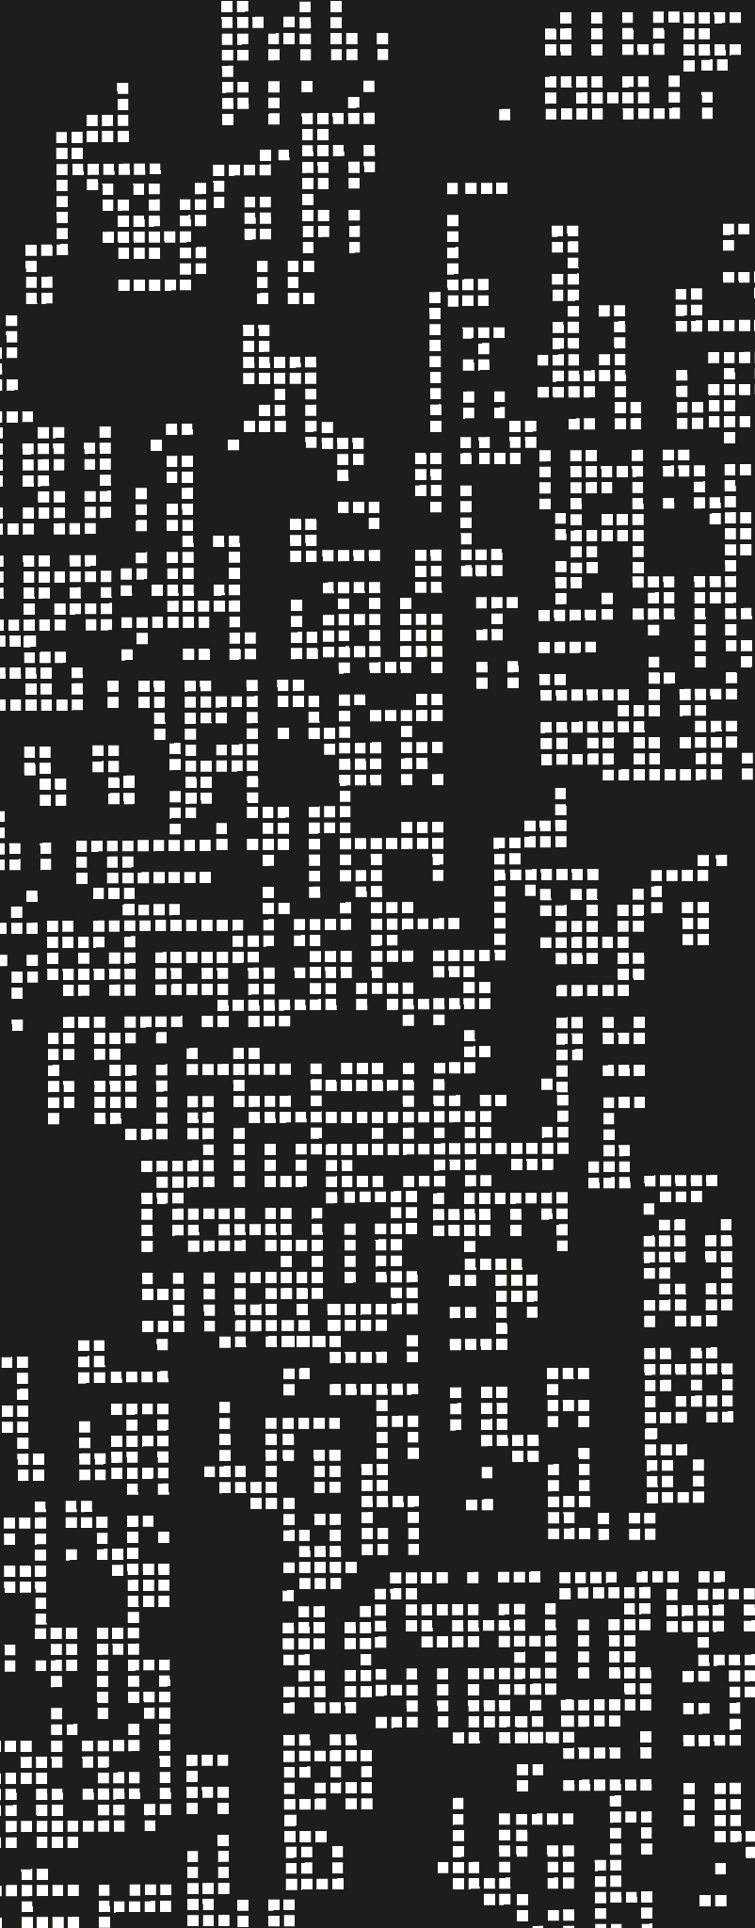
WaveNet’s Applications in Signal Denoising and Source Separation
Jacob Lamadrid
Hovhannes Broyan

Slide 2
Motivation & Goal of Project
Vocal Isolation | Vocal isolation is a source separation task involving taking the raw audio of music in the form of its instrumentation and vocals and training a model to differentiate the two
WaveNet | WaveNet is a CNN that was first proposed for generating raw audio and has applications in generating music, speech, text-to-speech, and speech recognition [1]
WaveNet for Speech Denoising | The WaveNet model was adapted for the speech denoising problem by using an identical network, but altering the output and optimization process [2]
Properites of the Model | WaveNet utilizes causal convolutions and dilation layers, among many other mechanisms, which both broadens the networks receptive field and dependencies of audio data
WaveNet for Vocal Isolation | We believe that due to the model’s architecture and previous applications in speech denoising, it may be possible to adapt the model’s architecture for vocal isolation
Goal | Test if the WaveNet model can effectively isolate vocals from musical compositions with significant instrumentation and maintain a high quality of audio output

Slide 3
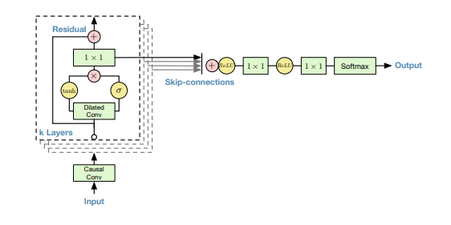
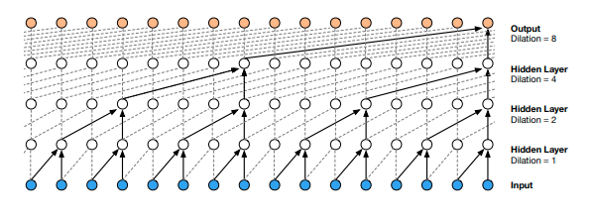
Overview of WaveNet
The WaveNet model is effective in generating raw audio due to its probability estimation capabilities, achieved through the utilization of dilated causal convolutions, enabling it to capture temporal dependencies of signals.
The model’s use of residual and skip connections is significant in maintaining its depth while allowing for faster training and convergence, enabling it to efficiently learn complex audio patterns.
Dilated Causal Convolutional Layers [1]
Residual and Skip Connections [1]

Slide 4
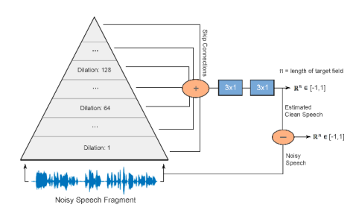
Our Solution
Adapt the WaveNet model similarly to the method proposed for speech denoising
3x1 final convolutions
Direct output of audio from the network instead of probability distribution
Discriminative model instead of autoregressive
Altered loss function and optimization
WaveNet for Speech Denoising Overview [2]

Slide 5
Our Solution
Architecture
Changed final convolution size
Changed output method of model
Optimization
Discrimination between output audio and clean vocals/speech signal
For vocal isolation, the STFT loss was used (Auraloss package)
For speech enhancement, the Sound-to-Noise Ratio (SNR) was used (Auraloss package)
Both utilized the Adam optimizer

Slide 6
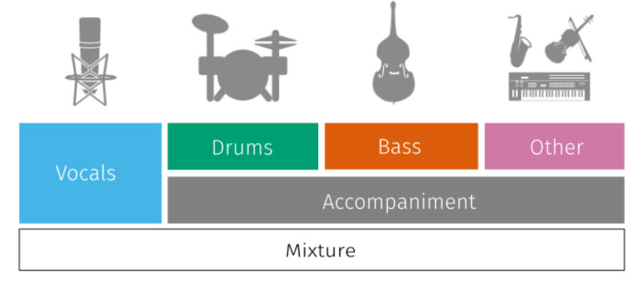
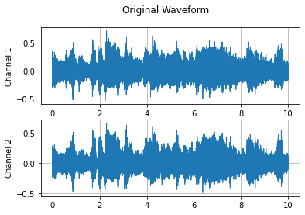
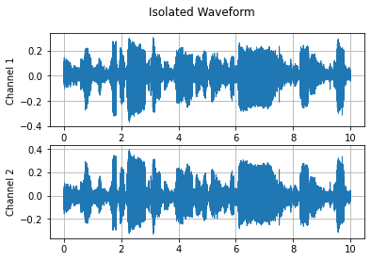
Training - Vocal Isolation
Input Stems
Raw Audio
Dataset
SigSep MUSDB18 [3]
150 tracks; 5 associated stems for each track
Stereo audio
Training Process
Preprocess stems into separate audio tracks, taking 10 seconds from 3 points within each song (30s, 45s, 60s)
Input raw audio of fully mixed song into WaveNet model
Compute the STFT loss of the output with the targeted clean vocal stem audio
Backpropagate and take optimization step using Adam, altering the model’s weights and biases
Epochs: 100; Learning Rate: 0.001
Model
WaveNet
Output Audio
Discriminate between output STFT and vocal STFT

Slide 7
Training - Speech Denoising
Input Noisy Speech
Model
Dataset
Dataset taken from “Speech Enhancement for a Noise-Robust Text-to-Speech Synthesis System using Deep Recurrent Neural Networks” [4]
Used only first 100 samples; One noisy sample and one associated clean sample
Mono audio
Training Process
Input raw audio of noisy speech into WaveNet model
Compute the SNR loss of the output with the targeted clean speech audio
Backpropagate and take optimization step using Adam, altering the model’s weights and biases
Epochs: 100; Learning Rate: 0.001
WaveNet
Output Audio
Compute Sound-to-Noise Ratio loss between the target clean speech and the model output

Slide 8

Results
Vocal Isolation
Speech Denoising
Original song
Original speech
Output vocals
Output speech

Slide 9
Results
Significant Drawbacks
Network half as deep as recommended due to memory
Limited layers, blocks, and channels
Vocal Isolation
Showed limited capabilities in source separation
Incapable of generalizing to multiple songs/artists at a time
Maintained vocal quality to a high degree
Speech Denoising
Fully capable of denoising speech, but the audio quality is hindered by limited layers

Slide 10
Outcomes
Vocal Isolation
Through our project we have shown capabilities of the WaveNet architecture to contribute to vocal isolation
Speech Denoising
We have also effectively reimplemented the WaveNet for speech denoising purposes
Limitations
Our model was significantly limited and it can be assumed that performance would be improved significantly with increasing layers/channels

Slide 11
Future Work
“Wave-U-Net: A Multi-Scale Neural Network for End-to-End Audio Source Separation” [5]
Trial with better memory capacity and computational power
Train model on entire datasets rather than fractions of the original
Combination of WaveNet and UNet models specific to source separation
Model performance was severly limited by our computational restraints
Our memory capacity and time alotted restricted us from using entire datasets

Slide 12
References
[1] Van den Oord, A., Kalchbrenner, N., & Kavukcuoglu, K. (2016). WaveNet: A Generative Model for Raw Audio. arXiv preprint arXiv:1609.03499.
[2] Pandey, S., & Wang, D. L. (2018). WaveNet for Speech Denoising. arXiv preprint arXiv:1802.04208.
[3] Rafii, Z., Liutkus, A., St{"o}ter, F.-R., Mimilakis, S. I., & Bittner, R. (2017). The {MUSDB18} corpus for music separation. Zenodo. doi:10.5281/zenodo.1117372. https://doi.org/10.5281/zenodo.1117372.
[4] Botinhao, C. V., Wang, X., Takaki, S., & Yamagishi, J. (2016). Speech Enhancement for a Noise-Robust Text-to-Speech Synthesis System using Deep Recurrent Neural Networks. Proceedings of Interspeech.
[5] Jansson, A., Humphrey, E., Montecchio, N., Bittner, R. M., Kumar, A., & Weyde, T. (2018). Wave-U-Net: A Multi-Scale Neural Network for End-to-End Audio Source Separation. arXiv preprint arXiv:1806.03185.

